Slide 1



INSPEKTORAT JENDERAL
KEMENTERIAN PERHUBUNGAN
Toward Data-Driven Anti-Fraud Governance: Anomaly Detection and Composite Risk Scoring for Port-Level Oversight in Digital Maritime Services
Introduction to artificial intelligence, its significance, and how Thynk Unlimited uses AI for innovation.

Slide 2

INSPEKTORAT JENDERAL
KEMENTERIAN PERHUBUNGAN
Outline
Introduction
Methodology
Result
Discussion
Conclusion
2

Slide 3
Introduction
INSPEKTORAT JENDERAL
KEMENTERIAN PERHUBUNGAN
Inaportnet has created digital transformation of vessel service process
create
the system is projected to reduce administrative duration from 24hours to approximately 10minutes (Directorate general of sea transportation, 2018)
Reduce face-to-face interaction (mitigating opportunities for fraud)
However, this measure does not automatically eliminate fraud risks.
It may transform to another fraudulent behaviour such as data manipulation, collusion among authorized actors, etc
With the massive volume of transactions, manual oversight becomes unfeasible.
3

Slide 4
Introduction
INSPEKTORAT JENDERAL
KEMENTERIAN PERHUBUNGAN
Research Gap
Research Objectives
Existing fraud analytics research has predominantly focused on financial transactions, with relatively limited attention to fraud risks embedded in administrative processes.
Fraud risk within digital maritime administrative processes remains relatively underexplored, particularly in large-scale port clearance and vessel approval systems.
Current supervisory practices tend to emphasize administrative compliance and service performance, rather than systematic, data-driven detection and prioritization of potential fraud risks.
To develop a data-driven Composite Fraud Risk Screening Index (CFRSI) to identify and prioritize potentially anomalous port-level transactions.
The key issue is not whether digitalization eliminates fraud, but whether we are able to detect abnormal behaviour hidden within millions of digital transactions.
4

Slide 5
Methodology
INSPEKTORAT JENDERAL
KEMENTERIAN PERHUBUNGAN
Data Collection
Data scrapping https://monitoring-inaportnet.dephub.go.id/
The dataset consists of all PKK transactions processed during 2025 observation period, covering 257 commercial ports across Indonesia and total 746,896 approval transaction.
Data Preparation
Exploratory, missing values identification
Feature Engineering:
Response Time, Hour, Day
Data preprocessing resulted 734,622
Anomaly Detection
Rule Based :
Approval < 10 s
Long Approval > 8 hours
Approval within 00.00 - 04.00
GT manipulation
Same vessel in 2 ports within 2 hours
Statistical Model
Unsupervised Machine Learning
Regression Model
3 Anomaly Detection
Isolation Forest
Modified Z Score
Model Evaluation
Composite Fraud
Risk Screening Index
Composite index
Risk Categorization
Port Risk Classification
5
Very Low
Low
Medium
High
Very High

Slide 6
Methodology
INSPEKTORAT JENDERAL
KEMENTERIAN PERHUBUNGAN
Why Three Methods?
Rule-Based
Modified Z-score
Unsupervised Machine Learning:
Isolation Forest
Violation of predefined operational red flags
Extreme statistical deviation
Multidimensional & nonlinear anomaly
Rule | Threshold | Rationale
Quick Approval | < 10 seconds | May indicate insufficient document verification.
Long Duration | > 8 hours | Prolonged processing may create opportunities for bribery or process manipulation.
Low Oversight | 00:00–04:00 | Approval during low-supervision hours may increase fraud exposure.
GT Manipulation | GT modified within 6 months | Frequent changes in vessel GT may indicate potential data manipulation.
Same Vessel in Two Ports | < 2 hours | Vessel movement between two ports within an implausibly short period represents an operational red flag.
Develop regression model as predicted approval duration
Model was trained on the full dataset using approval duration, vessel GT, service volume, and approval time to identify multidimensional anomalous patterns.
Develop regression model as predicted approval duration
residual anomalies were quantified using the Modified Z-Score based on Median Absolute Deviation (MAD)
6

Slide 7
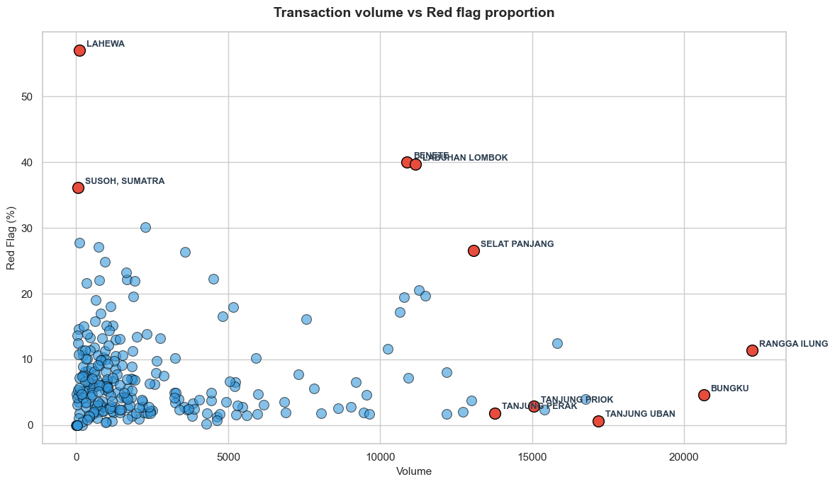
Result
INSPEKTORAT JENDERAL
KEMENTERIAN PERHUBUNGAN
734,622
PKK transactions analyzed
56,306
Rule-based red flags
465
Extreme statistical anomalies
(based on modified Z-score)
-0.36 to -0.75
Red flag (rule based) percentage on volume transaction across all ports
isolation forest anomaly scores, increasing negative scores represent unusual approval behavior
7

Slide 8
INSPEKTORAT JENDERAL
KEMENTERIAN PERHUBUNGAN
Result
Top 5 composite fraud risk scoring index
No | Port | Volume | Anomaly Detection Approach |  |  | Composite Index
 |  |  | Rule Based Index | Statistical Index | Machine Learning Index
1 | Lahewa | 107 | 1 | 0.86 | 0.45 | 0.77
2 | Samarinda | 954 | 0.28 | 0.76 | 1 | 0.68
3 | Pomako | 756 | 0.45 | 0.83 | 0.69 | 0.66
4 | Sinabang | 351 | 0.44 | 0.95 | 0.4 | 0.6
5 | Benete | 10867 | 0.73 | 0.74 | 0.29 | 0.59
No | Risk Category | Percentile approach |  | Fixed-scale
 |  | Range | Number of Port | Range | Number of Port
1 | Very High | 0.458 - 0.771 | 52 | 0.82 – 1.00 | 0
2 | High | 0.413 - 0.457 | 51 | 0.64 – 0.82 | 3
3 | Medium | 0.381 - 0.412 | 51 | 0.46 – 0.64 | 48
4 | Low | 0.352 - 0.380 | 51 | 0.28 – 0.46 | 185
5 | Very Low | 0.125 - 0.351 | 52 | 0.10 – 0.28 | 21
Classification of composite index based on percentile approach and fixed scale
8

Slide 9
Discussion
INSPEKTORAT JENDERAL
KEMENTERIAN PERHUBUNGAN
Fraud Risk Management
Future Research
Digital Transaction Data
Field Validation: Future research should validate the composite risk index through targeted field audits to assess its effectiveness as an early warning indicator.
Strategic Intervention: Future studies should integrate risk scores with service volume through quadrant analysis to develop more targeted and prioritized intervention strategies.
Methodological Scalability: Future research should extend the analytical architecture to other Inaportnet modules and administrative processes with high transaction volumes, heterogeneous units, and limited fraud labels.
Anomaly Detection
Composite Fraud Risk Screening Index
Risk Prioritization
Audit / Investigation
Validation & Feedback
Model Recalibration
9

Slide 10
Conclusion
INSPEKTORAT JENDERAL
KEMENTERIAN PERHUBUNGAN
Digital footprints can become anti-fraud intelligence. Inaportnet operational data can be used to detect patterns that deviate from normal conditions.
Hybrid detection is more informative
Rule-based, statistical, and machine learning approaches provide complementary perspectives on anomalies.
CFRSI is a prioritization tool, not a fraud verdict
CFRSI helps determine where supervisory resources should be allocated first, but the results still require field validation.
10

Slide 11
INSPEKTORAT JENDERAL
KEMENTERIAN PERHUBUNGAN
Thank you

